Slide 1
Lament, Despair and Hope in Creation Care

Slide 2
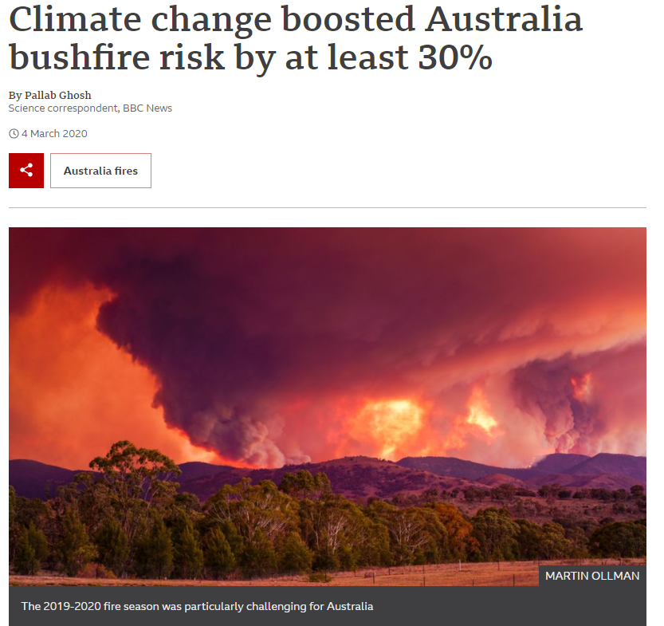
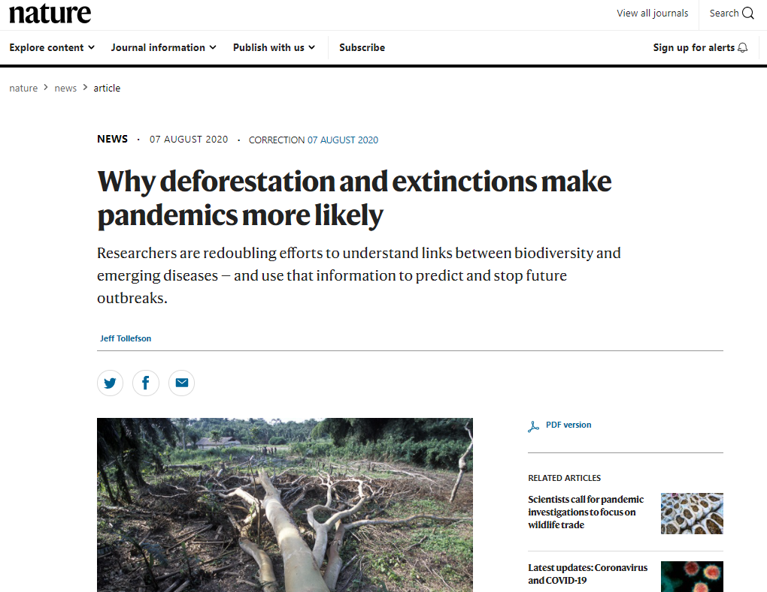
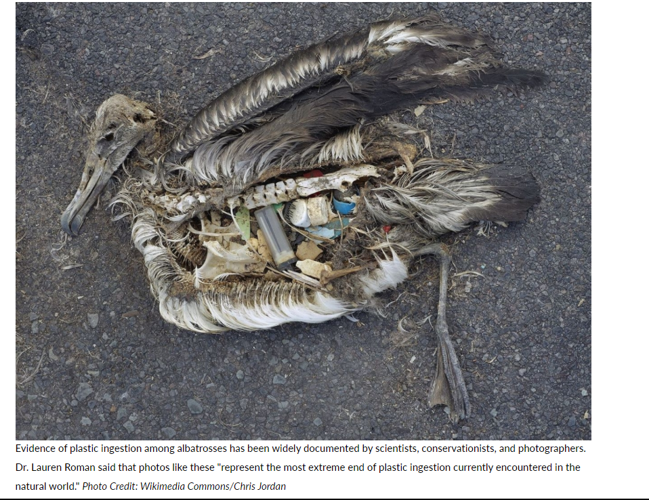
Creation is groaning (Romans 8)

Slide 3
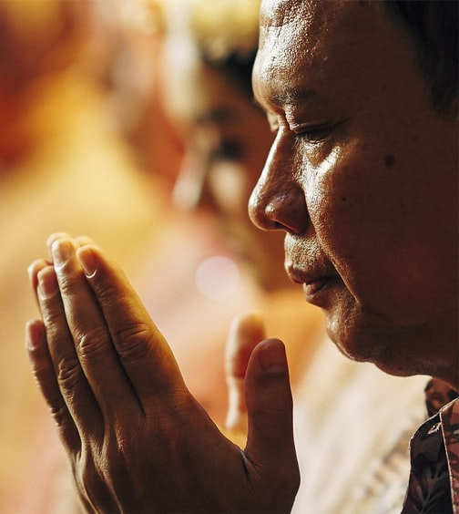
Lament
Address - “My God, My God…(22:1a)”
Complaint - “Why have you forsaken me? Why are you so far from helping me, from the words of my groaning?” (22:1b)
Confession of trust – “Yet you are holy, enthroned on the praises of Israel. In you our ancestors trusted; they trusted, and you delivered them.” (22:3-4)
Petition – “Do not be far from me, for trouble is near and there is no one to help.” (22:11)
Vow of praise – “From the horns of the wild oxen you have rescued me. I will tell of your name to my brothers and sisters; in the midst of the congregation I will praise you.” (22:21a-22)

Slide 4
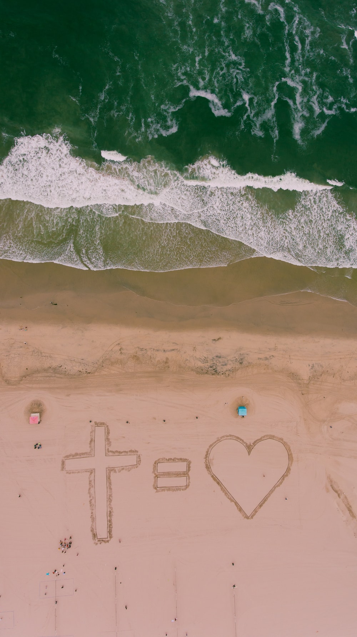
God loves the earth (Genesis, John 3)
He is committed to his creation on an ongoing basis (Colossians 1, John 1)
Humans have a role to play (Leviticus, Deuteronomy, obedience=blessing for land)
There is a promise of renewal (Revelation)

Slide 5
Creation is speaking

